Slide 1

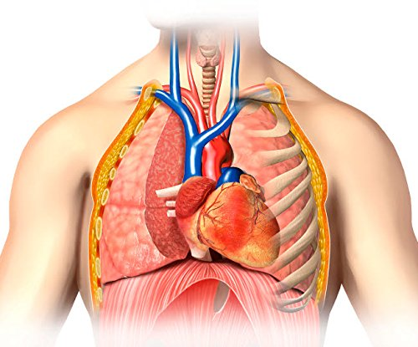
Predicting Pneumonia from Chest X-Rays using ML Models
Team - 9
Bhanu Rama Ravi Teja Gonugunta (2349943) Harshini Kodali (2348586) Praneetha Raju Buddharaju (2350205)

Slide 2
Contents
Introduction
About the Dataset
Data Pre-processing
ML Models
Conclusion

Slide 3
Introduction Why this Project ?
Global Health Challenge
Limitations of Traditional Diagnosis
Need for Scalable Solutions
Notes:
Global Health Challenge Pneumonia is a leading cause of death worldwide, claiming over 2.5 million lives annually, particularly affecting children under five and the elderly. Early detection is essential to reduce mortality rates.
Limitations of Traditional Diagnosis Conventional methods like chest X-rays and clinical evaluations often depend on subjective interpretation, leading to potential delays and inaccuracies in diagnosis.
Need for Scalable Solutions Many resource-limited settings lack access to experienced radiologists and diagnostic infrastructure. AI-based detection systems can bridge this gap and ensure equitable healthcare access.

Slide 4
Introduction Objective
Accurate and Early Diagnosis
Increased Accessibility
Supportive and Cost-Effective Healthcare
Notes:
The primary objective of this project is to develop a robust and efficient AI-powered system for the accurate detection of pneumonia using chest X-ray images. The system is intended to achieve the following goals:
Accurate and Early Diagnosis: To develop an AI-based system that detects pneumonia from chest X-ray images with high precision, enabling timely intervention and reducing complications.
Increased Accessibility: To create a scalable solution that provides reliable diagnostic support in resource-limited settings lacking expert radiologists.
Supportive and Cost-Effective Healthcare: To assist medical professionals by reducing diagnostic workloads and delivering an affordable tool for improving global health outcomes.

Slide 5
About the Dataset
The dataset is organized into 3 folders (train, test, val) and contains subfolders for each image category (Pneumonia/Normal). There are 5,863 X-Ray images (JPEG) and 2 categories (Pneumonia/Normal).
Chest X-ray images (anterior-posterior) were selected from retrospective cohorts of pediatric patients of one to five years old from Guangzhou Women and Children’s Medical Center, Guangzhou. All chest X-ray imaging was performed as part of patients’ routine clinical care.
Source: https://www.kaggle.com/datasets/paultimothymooney/chest-xray-pneumonia

Slide 6
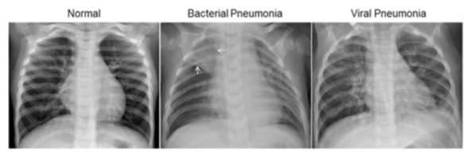
About the Dataset Examples of Chest X-Rays
Notes:
The normal chest X-ray (left panel) depicts clear lungs without any areas of abnormal opacification in the image.
Bacterial pneumonia (middle) typically exhibits a focal lobar consolidation, in this case in the right upper lobe (white arrows),
whereas viral pneumonia (right) manifests with a more diffuse ‘‘interstitial’’ pattern in both lungs.

Slide 7
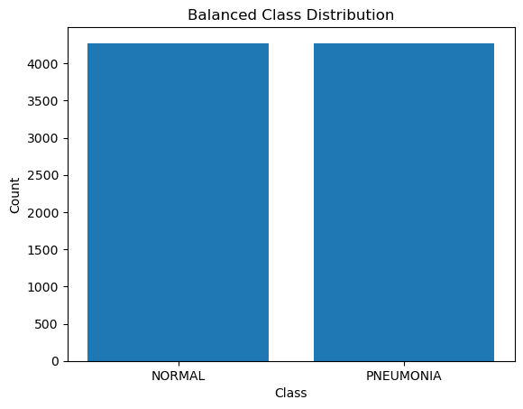
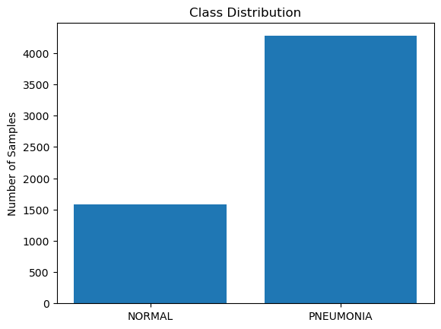
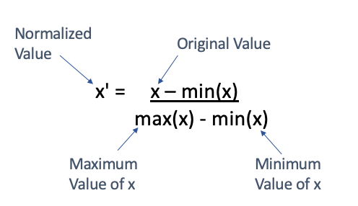
Data Preprocessing
Organizes and Preprocessing:
Balancing the Dataset:
Feature Scaling – MinMax Scaling:
Notes:
Organizes and Preprocessing: Initially, we organizes and preprocesses the chest X-ray dataset by loading, resizing, and labeling images from different folders (train, test, val). It ensures the data is ready for machine learning tasks while maintaining class-specific labels for NORMAL and PNEUMONIA.
Balancing the dataset: If a model is trained on an imbalanced dataset, it may become biased towards the majority class, leading to poor performance in detecting or classifying the minority class. It is possible, using SMOTE function in Python.
Feature Scaling: The dataset is scaled using MinMaxScaler, which normalizes the feature values to a range between 0 and 1. This helps improve the performance of machine learning algorithms, especially those sensitive to the scale of input features, such as gradient-based methods.

Slide 8

ML Models
We have used:
SVC - Support Vector Classifier
Naive Bayes
ANN - Artificial Neural Networks
K - means clustering
Random Forest
KNN
Logistic Regression
Why ?
Notes:
Using multiple models allows for comparing performance and selecting the best model for pneumonia detection. Each model offers different strengths, helping to capture various patterns in the data for improved accuracy.

Slide 9
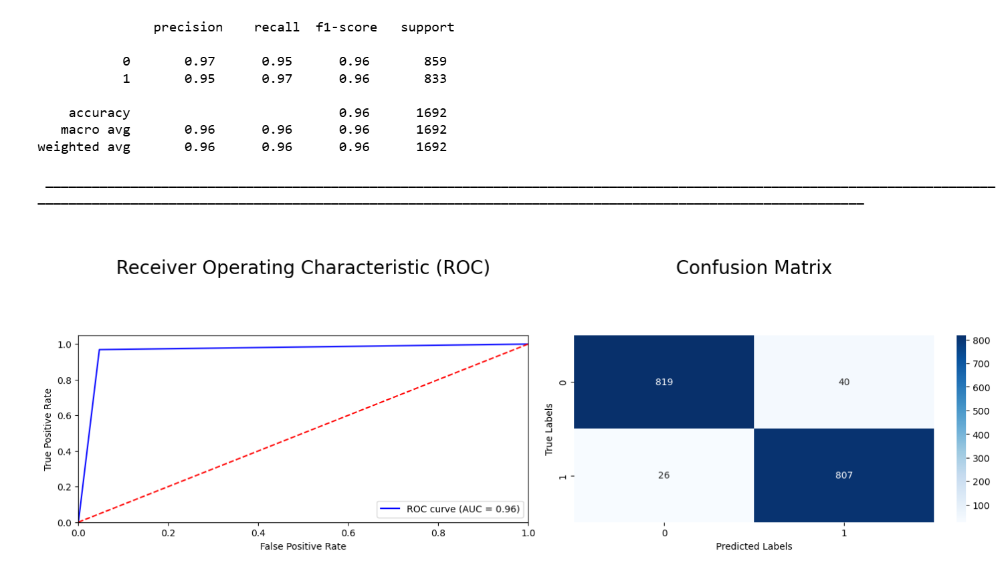
ML Models SVC - Support Vector Classifier
Results:
SVC (Support Vector Classifier): SVC effectively identifies the optimal decision boundary between "normal" and "pneumonia" classes, making it highly useful for accurately classifying X-ray images with clear distinctions.
Implementation Details:
from sklearn.svm import SVC
Results:
Accuracy - 0.96

Slide 10
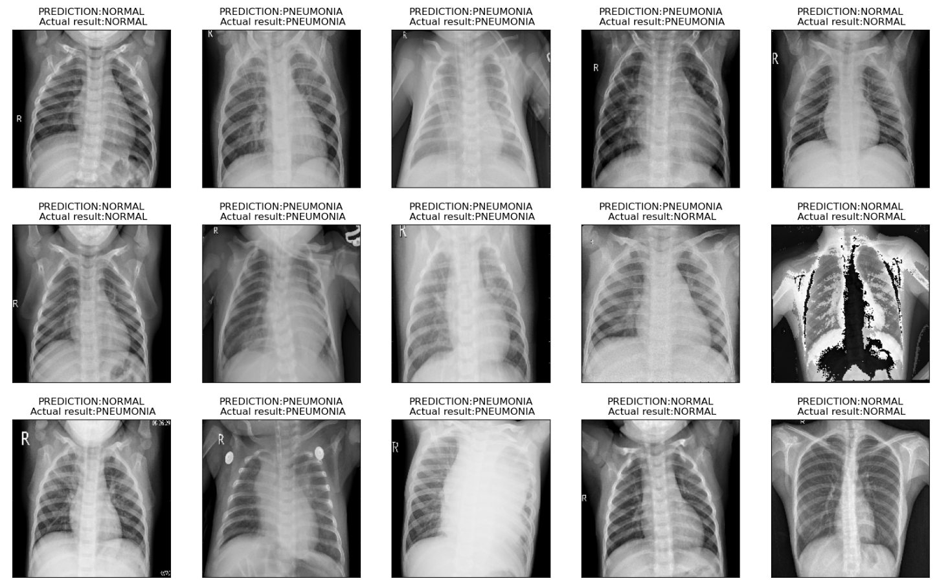
ML Models SVC - Support Vector Classifier
Visualize the process

Slide 11
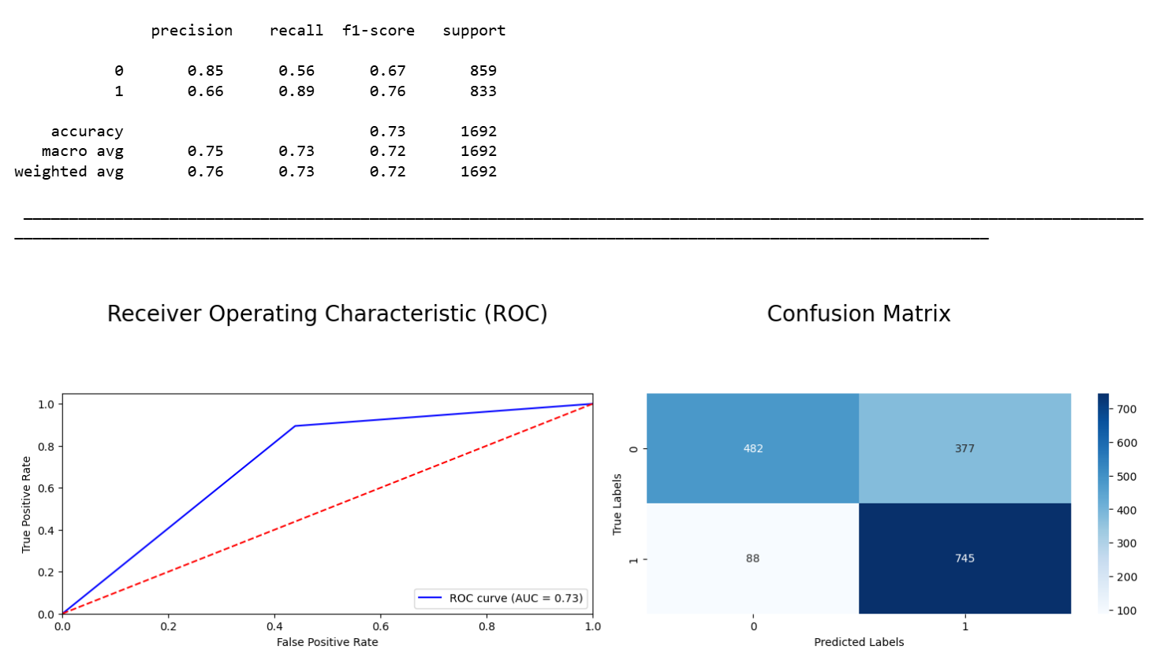
ML Models Naive Bayes
Results:
Naive Bayes: Naive Bayes offers a simple probabilistic approach, providing quick and efficient predictions, especially for smaller datasets or when computational resources are limited, contributing to early detection of pneumonia.
Implementation Details:
from sklearn.naive_bayes import GaussianNB
Results:
Accuracy - 0.73

Slide 12
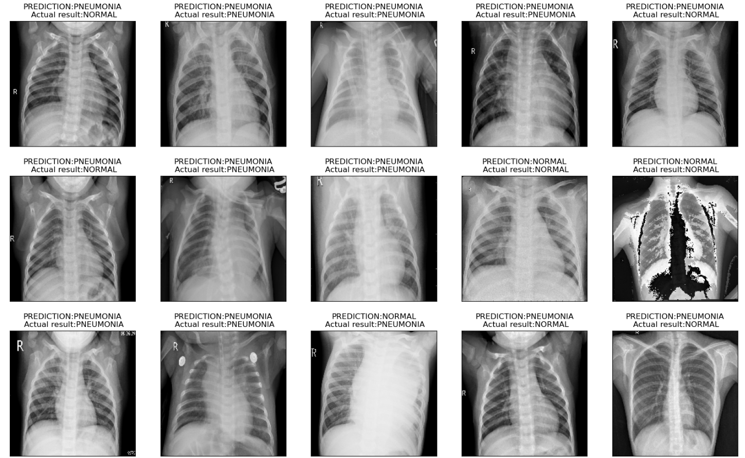
ML Models Naive Bayes
Visualize the process

Slide 13
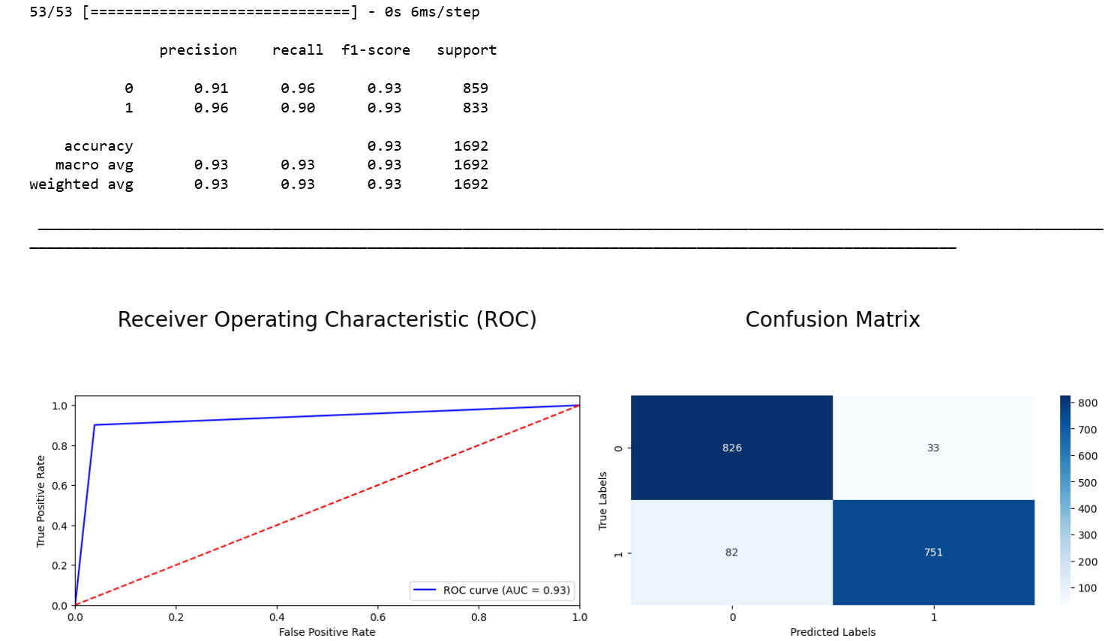
ML Models ANN - Artificial Neural Networks
Results:
ANN (Artificial Neural Networks): ANN captures complex, non-linear relationships in data, enabling it to learn intricate patterns in X-ray images, making it highly effective for deep learning-based pneumonia detection.
Implementation Details:
import tensorflow as tf
tf.keras.layers.Dense(num_nodes, activation='relu', input_shape=(None,40000)),
tf.keras.layers.Dropout(dropout_prob),
tf.keras.layers.Dense(num_nodes, activation='relu'),
tf.keras.layers.Dropout(dropout_prob),
tf.keras.layers.Dense(1, activation='sigmoid’)
Result:
Accuracy – 0.93

Slide 14

ML Models ANN - Artificial Neural Networks
Visualize the process

Slide 15
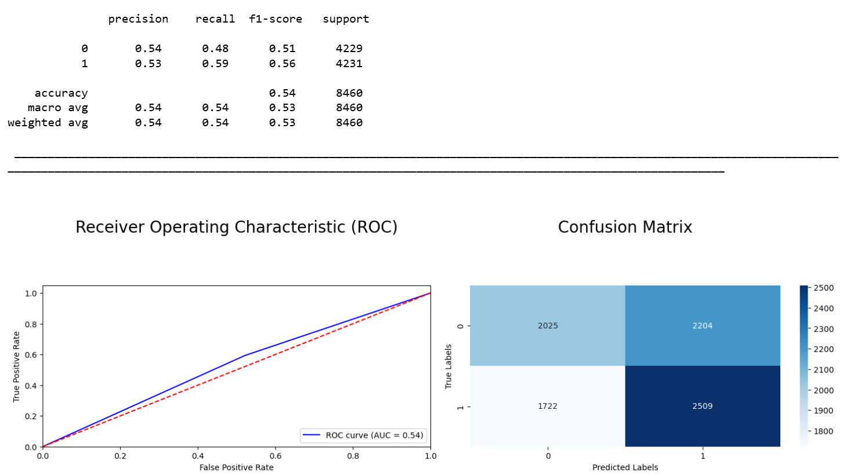
ML Models K - means clustering
Results:
K-means Clustering: K-means helps group similar X-ray images together, which can reveal underlying patterns or anomalies, potentially aiding in feature extraction or identifying new data trends in pneumonia detection.
Implementation Details:
from sklearn.cluster import KMeans
scaler = preprocessing.MinMaxScaler()
data_x = scaler.fit_transform(data_x_updated)
Result:
Accuracy – 0.54

Slide 16

ML Models K - means clustering
Visualize the process
Notes:
K-means clustering may still underperform for pneumonia detection because it assumes that the data naturally forms spherical clusters, which may not align with the complex features in X-ray images. Additionally, K-means doesn't learn from labeled data, making it less effective for tasks like pneumonia classification compared to other supervised models like SVC or Random Forest.

Slide 17
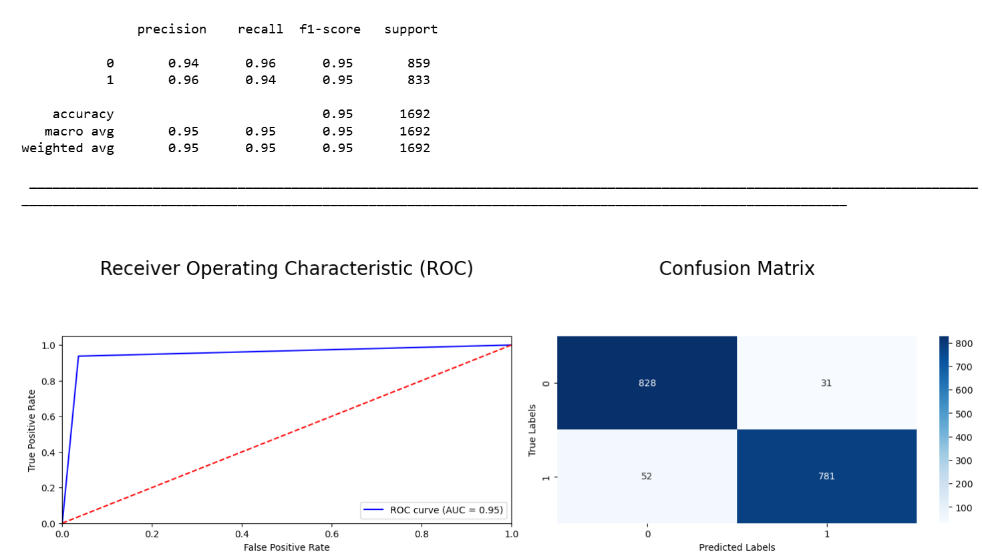
ML Models Random Forest
Results:
Random Forest: By combining multiple decision trees, Random Forest improves classification robustness, handling complex, noisy data and increasing accuracy in pneumonia detection by reducing overfitting.
Implementation Details:
from sklearn.ensemble import RandomForestClassifier
rf = RandomForestClassifier(n_estimators=100, random_state=42)
Results:
Accuracy – 0.95

Slide 18
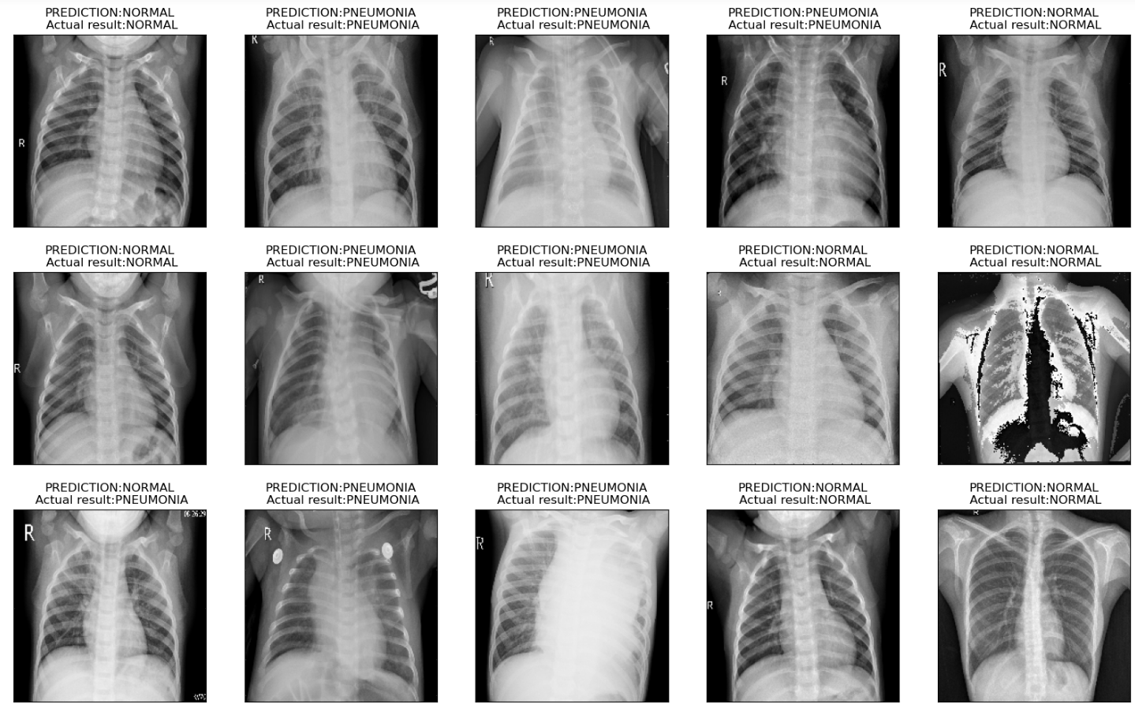
ML Models Random Forest
Visualize the process

Slide 19
ML Models KNN & Logistic Regression
KNN: KNN identifies pneumonia by comparing a test sample to its nearest neighbors in the feature space, relying on distance metrics.
Result:
Accuracy – 0.76
Logistic Regression: Logistic Regression is effective for binary classification problems like pneumonia detection, modeling the probability of a patient having pneumonia.
Result:
Accuracy – 0.91

Slide 20
Compromission of ML Models
Notes:
SVC achieved high accuracy for pneumonia detection because it effectively handles high-dimensional data and complex patterns, such as those in X-ray images. By using the **RBF kernel**, it creates non-linear decision boundaries, enabling precise separation between pneumonia and normal cases, even when the data distributions are not linearly separable.
K-means clustering may still underperform for pneumonia detection because it assumes that the data naturally forms spherical clusters, which may not align with the complex features in X-ray images. Additionally, K-means doesn't learn from labeled data, making it less effective for tasks like pneumonia classification compared to other supervised models like SVC or Random Forest.

Slide 21
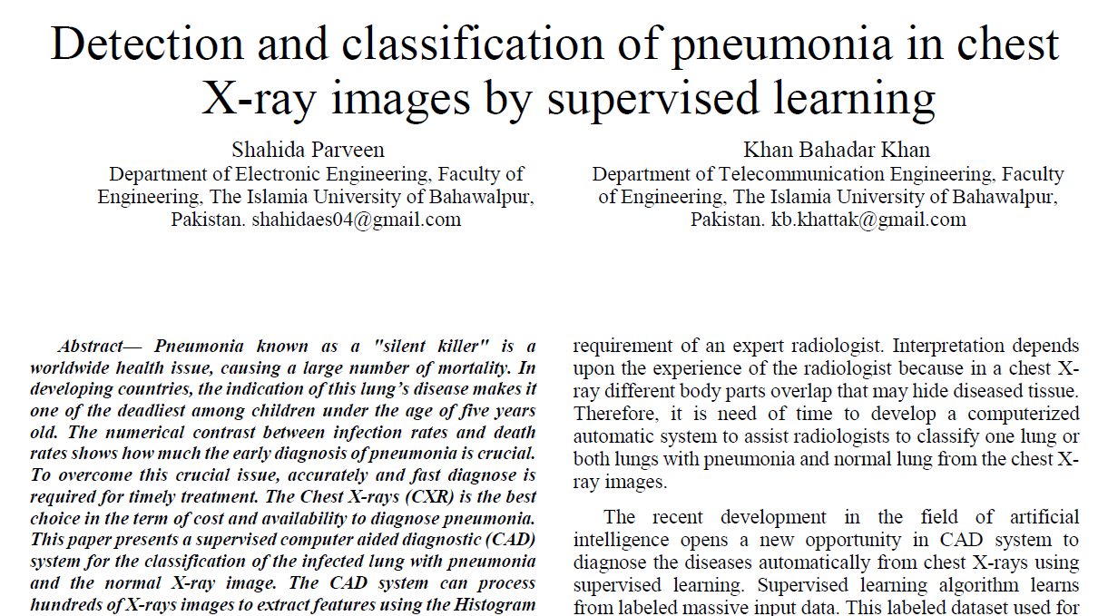
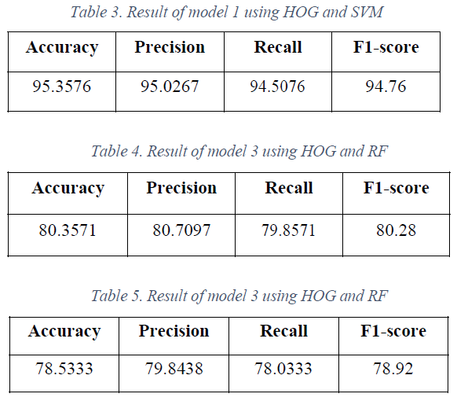
Research Study

Slide 22
Conclusion
In our pneumonia detection project, we implemented and evaluated multiple machine learning models, including SVC, Random Forest, Naive Bayes, ANN, K-means clustering, Logistic Regression and KNN.
Among these, the Support Vector Classifier (SVC) outperformed the others, achieving an impressive 96% accuracy.
This highlights the effectiveness of SVC in handling complex medical imaging data and distinguishing between normal and pneumonia cases.
Notes:
The results demonstrate the potential of machine learning models, particularly SVC, in supporting accurate and reliable pneumonia diagnosis, paving the way for enhanced diagnostic assistance in healthcare.

Slide 23
